Slide 1
Objectives
Data runs
Whole disk encryption
Ways of hiding data
NTFS Alternate Data Streams
Bit shifting
Steganography tools
Windows thumbcache

Slide 2
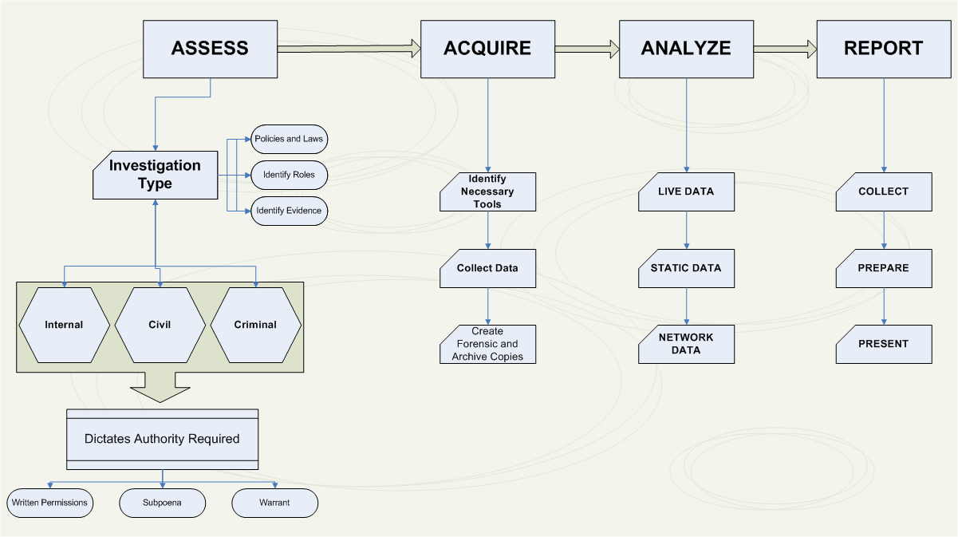

Slide 3
Analysis Techniques
Registry analysis (Windows)
File carving
Recovery of deleted files
Crack passwords/defeat encryption
Examine log files
Establish patterns/determine deviations from norms
Run images in virtual machine
Observe behavior
Memory capture/analysis
See what was running on the machine

Slide 4
Analysis Techniques (cont.)
Web browser forensics
History, cache, stored passwords, cookies, etc.
Examine hard drive using a live CD
Usually Linux distribution
Examine hard drive without booting the machine
Packet capture analysis
Router span port or intrusion detection system
Email analysis
Determine user activities
Search for hidden or encrypted files, steganography, alternate data streams
Create network map

Slide 5
NTFS
Files larger than 512 bytes are stored outside the MFT.
The file or folder’s MFT record provides cluster addresses where the file is stored on the drive’s partition.
These cluster addresses are called data runs.
This type of MFT record is referred to as “nonresident” because the file’s data is stored in its own separate file outside the MFT.

Slide 6
NTFS Alternate Data Streams
Alternate data streams
Ways data can be appended to existing files
Can obscure valuable evidentiary data, intentionally or by coincidence
In NTFS, an alternate data stream becomes an additional file attribute
Allows the file to be associated with different applications
You can only tell whether a file has a data stream attached by examining that file’s MFT entry

Slide 7
Alternate data streams
Alternate data streams are hidden files that are attached to visible ones.
Few security programs that can recognize them

Slide 8
Whole Disk Encryption
In recent years, there has been more concern about loss of
Personal identity information (PII) and trade secrets caused by computer theft
Of particular concern is the theft of laptop computers and handheld devices
To help prevent loss of information, software vendors now provide whole disk encryption.
This feature creates new challenges in examining and recovering data from drives.

Slide 9
Whole Disk Encryption
Current whole disk encryption tools offer the following features:
Preboot authentication
Full or partial disk encryption with secure hibernation
Advanced encryption algorithms
Key management function
The integration of encryption into operating systems, specifically full disk encryption (FDE), is making recovery of digital evidence more difficult.

Slide 10
Pre-boot authentication
Pre-boot authentication with BitLocker is a policy setting that password→ authenticate prior to making the contents of the system drive accessible.
BitLocker accesses and stores the encryption keys in memory only after pre-boot authentication is completed
If Windows can’t access the encryption keys, the device can’t read or edit the files on the system drive.
Pre-boot authentication is designed to prevent the encryption keys from being loaded to system memory authentication

Slide 11
Challenges – whole disk
US Customs observed possible child pornography on Sebastien Boucher’s laptop but did not realize that it was stored in a Pretty Good Privacy (PGP) encrypted container that was open and assigned drive letter “Z” at the time of the inspection.
The laptop was shutdown and a forensic duplicate of the hard drive was created, but forensic examiners could not open the PGP encrypted container.
A Grand Jury Subpoena to compel Boucher to provide his password for decrypting the data was denied on the grounds that it violated his Fifth Amendment right against self-incrimination

Slide 12
Whole Disk Encryption
Whole disk encryption tools encrypt each sector of a drive separately
Many of these tools encrypt the drive’s boot sector
To prevent any efforts to bypass the secured drive’s partition
To examine an encrypted drive, decrypt it first
Run a vendor-specific program to decrypt the drive
Many vendors use a bootable CD or USB drive that prompts for a one-time passphrase

Slide 13
Data-Hiding Techniques
Data hiding - changing or manipulating a file to conceal information
Techniques:
Hiding entire partitions
Changing file extensions
Setting file attributes to hidden
Bit-shifting
Using encryption
Setting up password protection

Slide 14
Bit-Shifting
Some users use a low-level encryption program that changes the order of binary data
Makes altered data unreadable to secure a file, users run an assembler program (also called a “macro”) to scramble bits
Run another program to restore the scrambled bits to their original order
Bit shifting changes data from readable code to data that looks like binary executable code
WinHex and Hex Workshop includes a feature for shifting bits

Slide 15
Thumbcache files
Various computer operating systems include the ability to view picture and other files within a folder as smaller thumbnail images, representative of the file contents.
In MS Windows –
Thumbs.db, or later; Thumbcache.db files
A range of court cases involving thumbnail pictures have been presented to a court.

Slide 16
Picture file crimes:
Sexually related crimes, pornography, drug offences, and insider threat cases, where pictures can potentially exist as thumbnail entries within operating system files.
Example:
A suspect could be selling intellectual property in the form of pictures of new and unreleased technology to competitors.

Slide 17
Erasing pictures
If a suspect has erased pictures, there may still be evidence in thumbcache files, but this alone may not be enough to provide grounds for legal action.
By conducting further analysis data maybe found in the windows.edb file, may be enough to provide grounds for legal action.
The Windows.edb file is a hidden file, located in the following folder (faster searches)
C:\ProgramData\Microsoft\Search\Data\Applications\Windows\Windows.edb

